Slide 1
Modularization:
Process of dividing a software system into multiple independent modules where each module works independently.
Benefits of Modularity:
Modularity let the development of software be divided into several components that can be implemented simultaneously by the team of developers. ...
Modularity makes the components of the software reusable.
As modularity breaks the large complex program into components, it improves manageability. ...
It is also easy to debug and trace the error in modular programs.

Slide 2
Coupling & Cohesion

Slide 3
Cohesion:
Cohesion refers to the degree to which elements within a module work together to fulfill a single, well-defined purpose.
High cohesion means that elements are closely related and focused on a single purpose, while low cohesion means that elements are loosely related and serve multiple purposes.

Slide 4
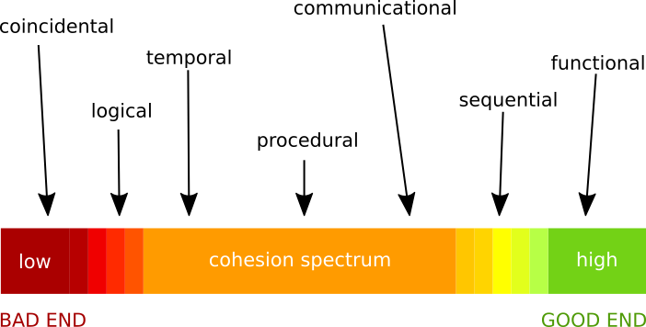
Software Patterns
TYPES OF COHESION

Slide 5
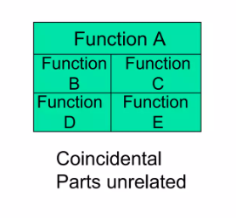
Coincidental Cohesion
Coincidental cohesion is when parts of a module are grouped arbitrarily; the only relationship between the parts is that they have been grouped together.
Utility Class
Transaction Processing System

Slide 6
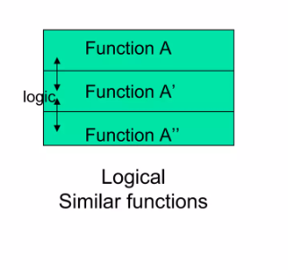
Logical Cohesion
Logical cohesion is when parts of a module are grouped because they are logically categorized to do the same thing, even if they are different by nature (e.g. grouping all mouse and keyboard input handling routines).
Print functions
Input handling functions

Slide 7
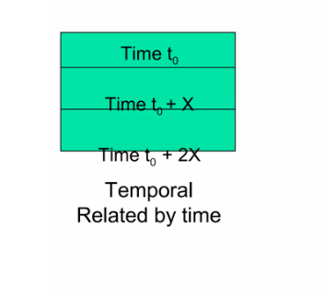
Temporal Cohesion
Temporal cohesion is when parts of a module are grouped by when they are processed – the parts are processed at a particular time in program execution.
The set of functions responsible for initialization, start-up, shutdown of some process, etc. exhibit temporal cohesion.

Slide 8
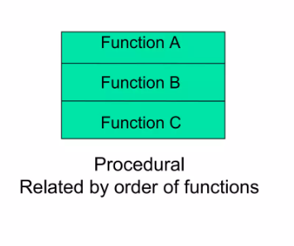
Procedural Cohesion
A module is said to possess procedural cohesion, if the set of functions of the module are all part of a procedure (algorithm) in which certain sequence of steps have to be carried out for achieving an objective.
A function which checks file permissions then opens the file.
Decoding algorithm

Slide 9
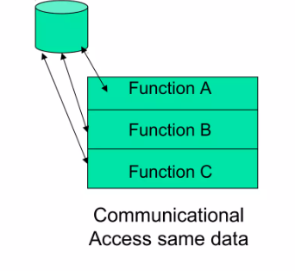
Communicational Cohesion
Aka informational cohesion
A module is said to have communicational cohesion, if all functions of the module refer to or update the same data structure. Elements contribute to activities that use the same input or output data.
Functions working on array/stack
Customer banking module

Slide 10
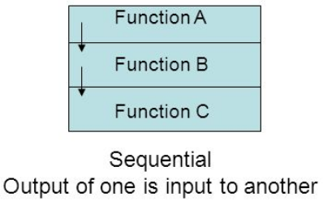
Sequential Cohesion
Sequential cohesion - each function or component is designed to perform a specific task and the output from one function serves as the input for the next one.
We group such elements because of their sequence of data processing.
Notes:
If we have such a sequence, we can cut it in different ways. It means that created classes can do more than one functionality, or quite the opposite – only some part of the functionality. That’s the only reason why in the hierarchy of cohesion types it stands below the last one, which is functional cohesion.

Slide 11
Sequential Cohesion - Example
Consider a software system designed to manage a library's operations. One module in this system is designed to handle the borrowing and returning of books.
Function 1: Search and Display Book Information
Function 2: Verify Member Information
Function 3: Check Book Availability
Function 4: Update Book Status (borrowed/returned)
Notes:
Sequential cohesion in this module can be seen as follows:
Each function in this module serves a single purpose and builds on the previous one, leading to a clear, cohesive, and modular design.

Slide 12
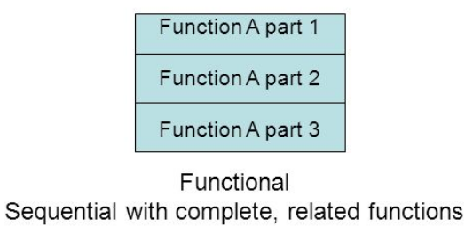
Functional Cohesion
Functional cohesion is when parts of a module are grouped because they all contribute to a single well-defined task of the module.
Focused (strong, single minded purpose)
No element doing unrelated activities.
Notes:
Every essential element to a single computation is contained in the element/component. This is hence the highest form of cohesion and thus ideal.

Slide 13
Functional Cohesion - Example
Examples of functionally cohesive modules include
reading a particular file.
computing the cosine of an angle.
calculating shipping costs for an order.

Slide 14
COUPLING
Coupling in refers to the degree of interdependence between different components or modules in a software system. It describes the way in which one module affects or relies on another module.
The goal of software design is to reduce coupling as much as possible, to improve the modularity, maintainability, and reusability of the system.

Slide 15
LOW or HIGH coupling?
Low coupling is desirable in software design, as it means that each module is independent and can be modified or reused without affecting other parts of the system.
High coupling, on the other hand, can lead to complex and confusing systems, as changes in one module can have unexpected effects on other parts of the system.

Slide 16
Low coupling 🡪 flexible and scalable systems High coupling 🡪 makes it challenging to modify or maintain the system

Slide 17
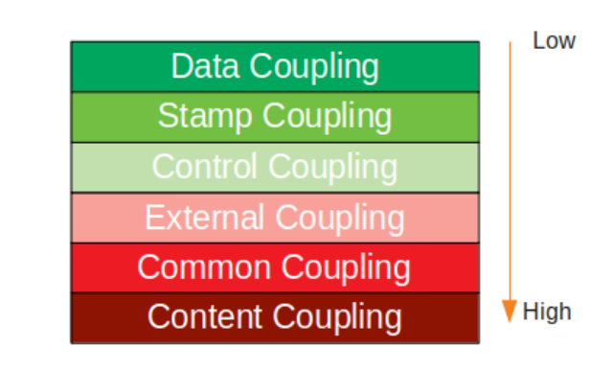
Types of COUPLING

Slide 18
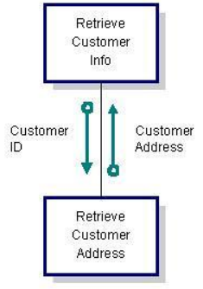
DATA COUPLING
Data coupling occurs between two modules when data are passed by parameters using a simple argument list and every item in the list is used.
An example of data coupling is illustrated as a module which retrieves customer address using customer id.

Slide 19
DATA COUPLING
Use data coupling when the argument list is small. As a rule of thumb, limit the argument list to three items.
Strength: A module sees only the data elements it requires.
Weakness: Easy to pass many data elements. Too many parameters can also indicate that a module has been poorly partitioned.

Slide 20
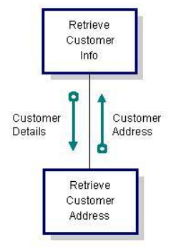
STAMP COUPLING
Stamp coupling occurs between modules when data are passed by parameters using a data structure containing fields which may or may not be used.
An example of stamp coupling illustrates a module that retrieves customer address using only customer id which is extracted from a parameter named customer details.

Slide 21
STAMP COUPLING
As a rule of thumb, never pass a data structure containing many fields to a module that only needs a few.
Strength: It simplifies interfaces between modules.
Weakness: bundling of unrelated data elements together in a structure.

Slide 22
CONTROL COUPLING
The manner or degree by which one software component influences the execution of another software component.
The main goal of control coupling is to ensure that the connectivity between the software modules is correct and complete.
The impact of this type of coupling on the software application can either be a positive one or a negative one

Slide 23
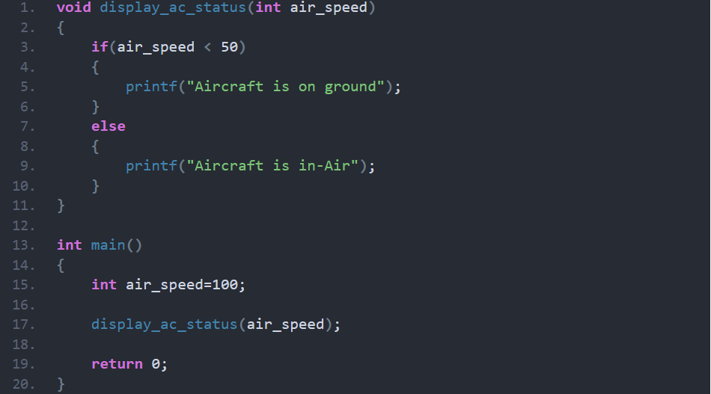
CONTROL COUPLING

Slide 24
COMMON COUPLING
Common coupling is one of the types of coupling in which two or more modules share some global data structures.
Any change performed on the global information field return and prompts every one of the modules that have gotten to the data through it.
It can make some transmission errors and unidentified issues when the changes are made to global information.
We can control this coupling by reducing the use of common global data or by separation.

Slide 25
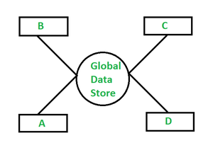
COMMON COUPLING
Common coupling goes under the classification of tight coupling which isn’t attractive .
Tight coupling implies that various modules inside a program are strongly subject to each other.
Typically, common coupling offers tight coupling which decreases the module’s adaptability and re-convenience.

Slide 26
CONTENT COUPLING
Content Coupling occurs when one module is directly dependent on the content of another module, such as its data structure or the specific values it contains.
In content coupling, a change in one module can cause significant changes in another module, leading to unexpected consequences.
This type of coupling can make the software system difficult to maintain, modify, and test.

Slide 27
CONTENT COUPLING
To avoid content coupling, it's recommended to use other software design patterns such as data abstraction and encapsulation, which promote loose coupling between modules.
Additionally, you can use design patterns such as inversion of control, and service-oriented architecture, which promote the separation of concerns between modules, further reducing the coupling between them.
In conclusion, content coupling can make software systems more rigid and harder to maintain

Slide 28
EXTERNAL COUPLING
External coupling occurs when one or more modules share a format, interface or communication protocol, that is imposed upon them.
the modules depend on other modules, external to the software being developed or to a particular type of hardware.
This usually happens when modules are in direct communication with infrastructure layers, e.g., OS functions.
In software design, it is important to minimize external coupling as much as possible to make the system more modular, flexible, and maintainable.

Slide 29
Thank You

